Slide 2
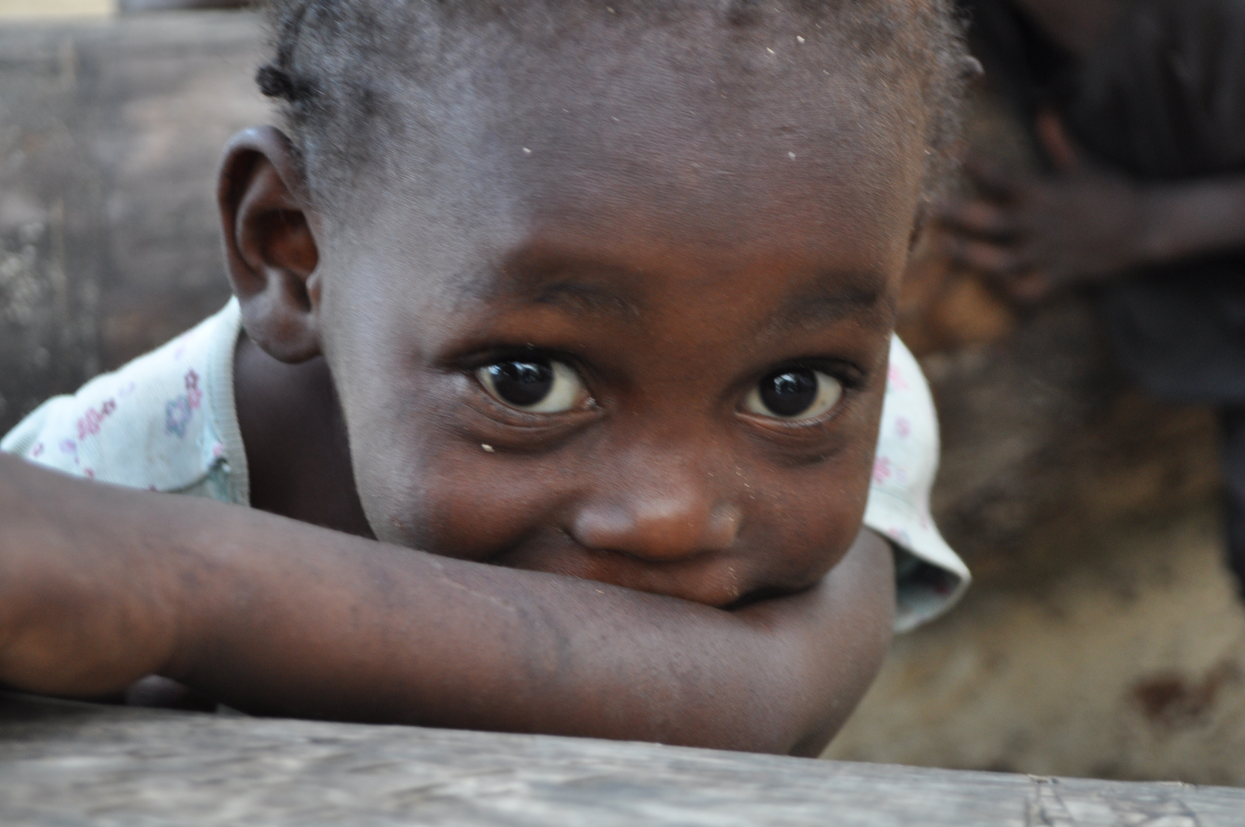
With God all things are possible. Matthew 19:26
“With God
all things are possible.”
Matthew 19:26

Slide 3
Our Lady of the Lake
has been twinned with
St. Bertin in Haiti
for 40 years.

Slide 4
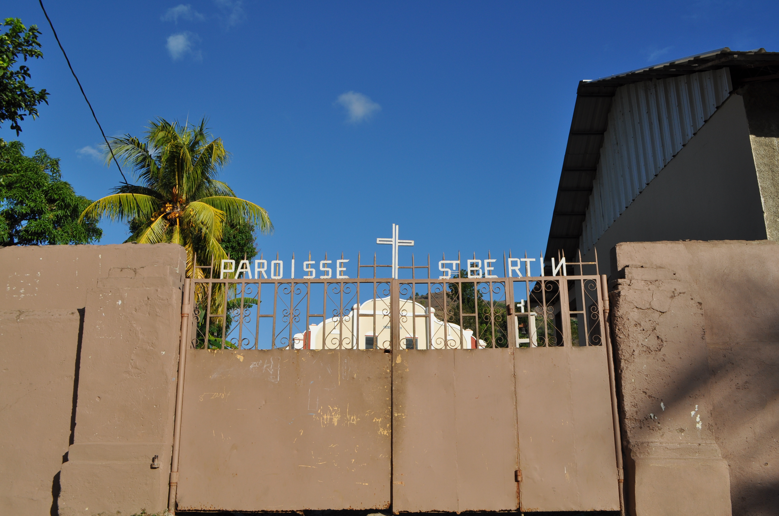

Slide 5
We have sponsored St. Bertin School since 2003.

Slide 6
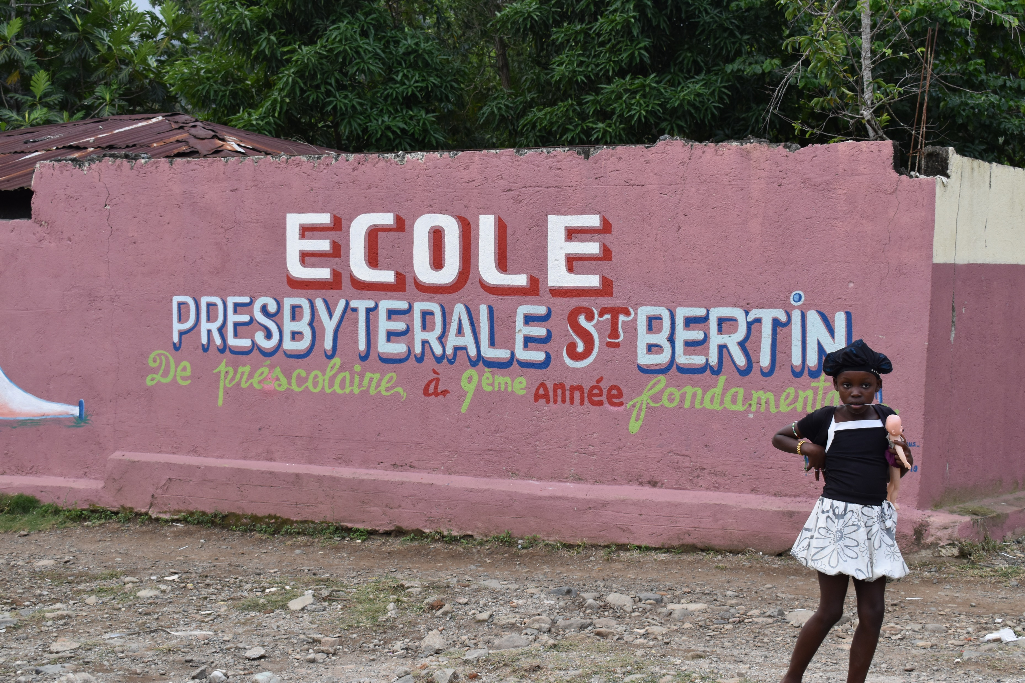

Slide 7
We have been faithful to this important mission
for 20 years.

Slide 8
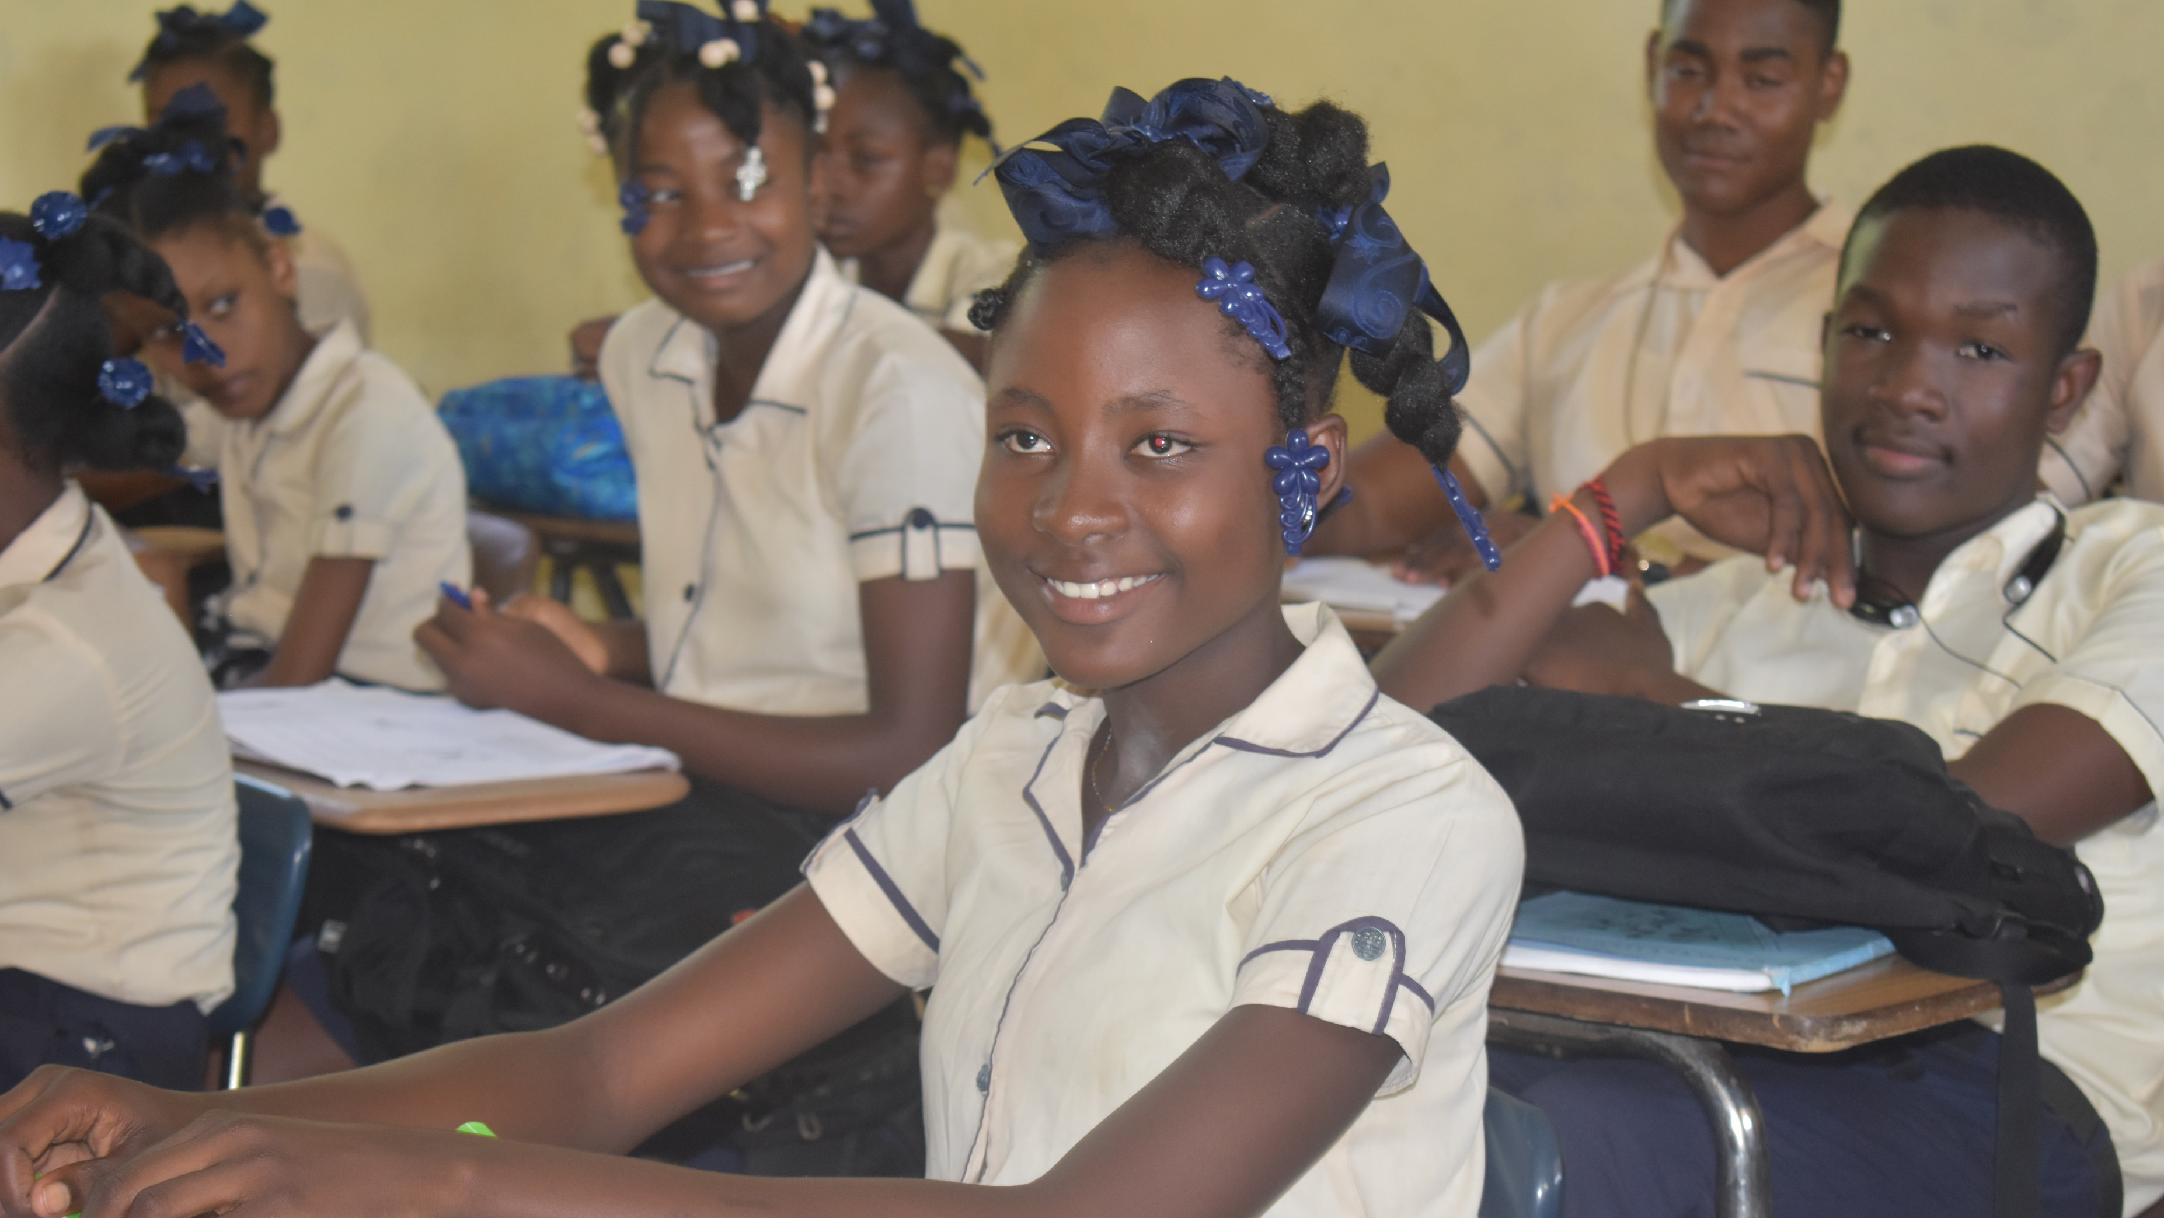
Thanks to OLOL’s faithful and generous support ,
St. Bertin School
is one of the best schools in the Archdiocese of Cap-Haitien

Slide 9
Thanks to God and to you,
more than 800 students attend St. Bertin School

Slide 10
… from preschool

Slide 11
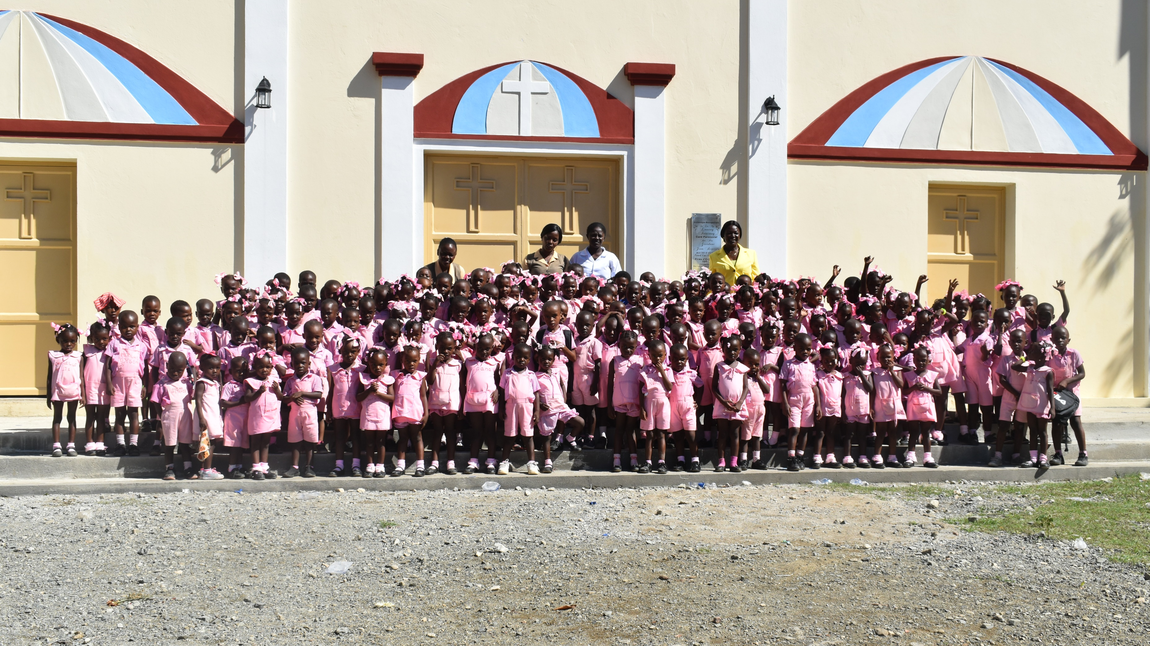

Slide 13
through primary school …

Slide 14
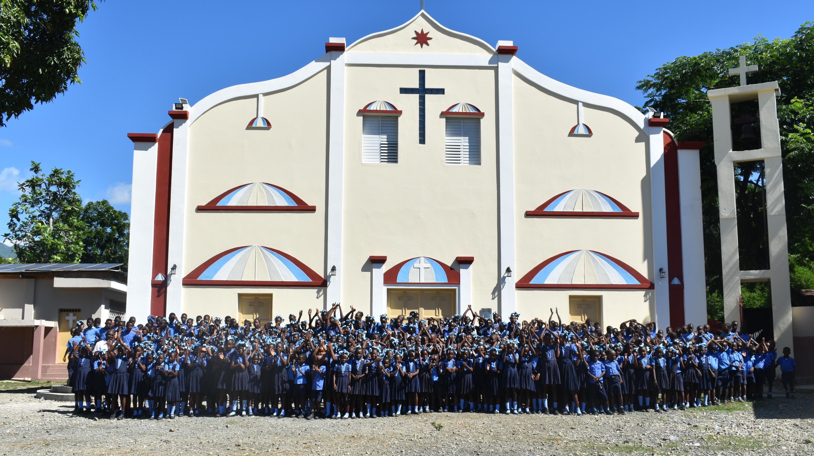

Slide 16
… middle school & high school.

Slide 17
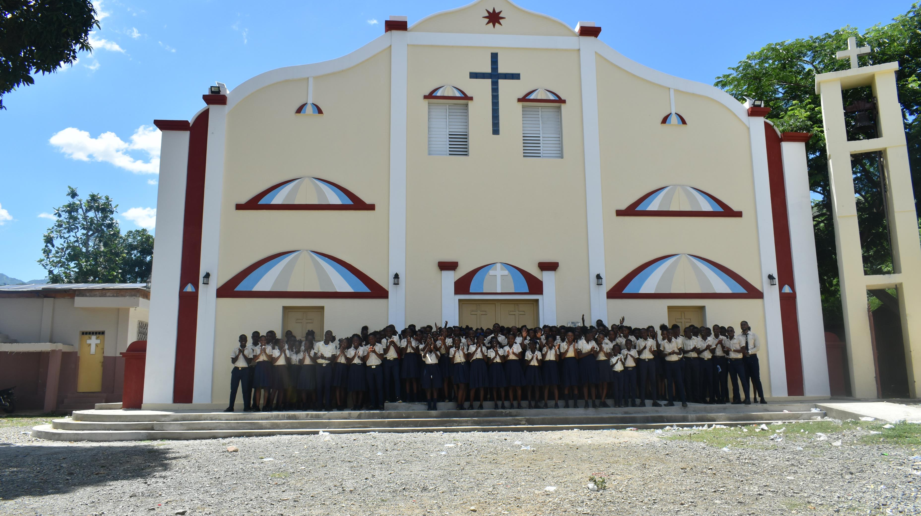

Slide 20
St. Bertin School
is one of the best schools in the Archdiocese of Cap-Haitien.

Slide 22
GREAT NEWS!
For the first time St. Bertin celebrated the graduation of
24 students in June!

Slide 23
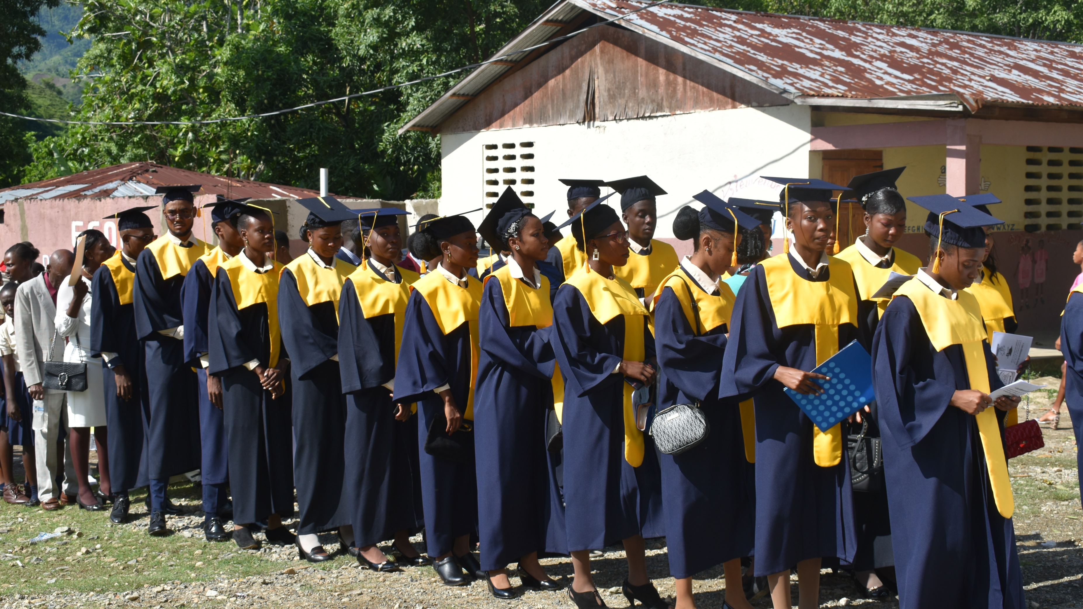

Slide 24
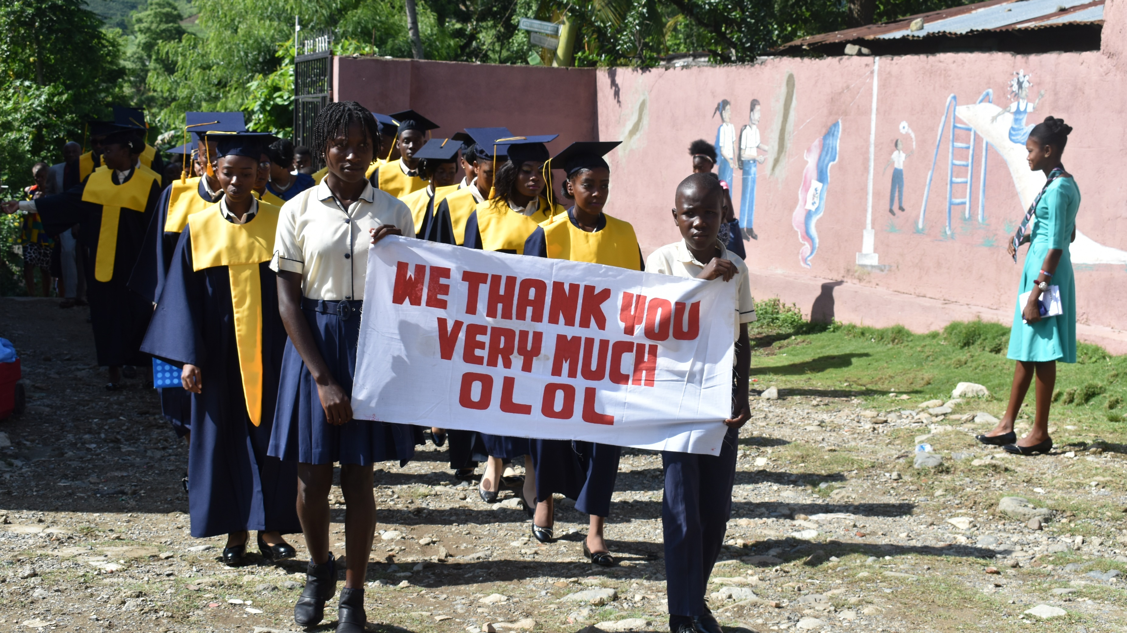

Slide 25
With a quality education, these graduates can now create a
brighter future for Haiti...

Slide 26
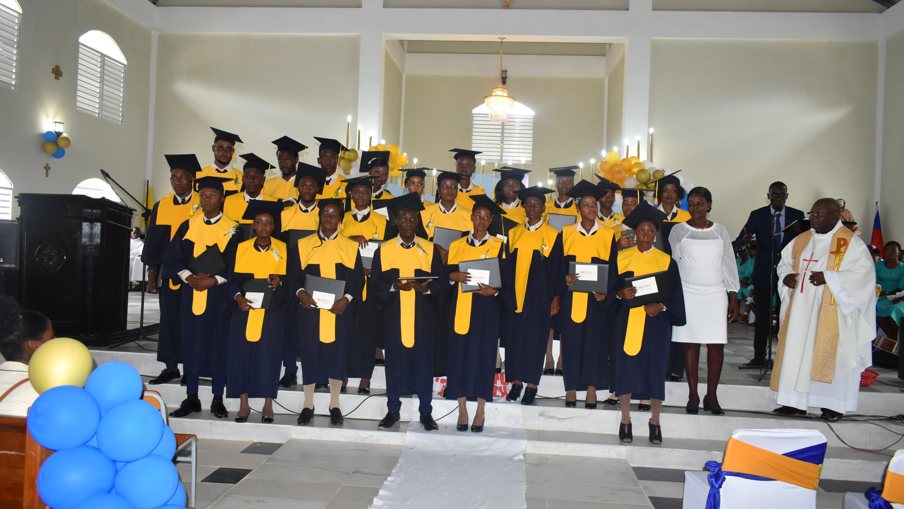

Slide 27
We need your help to raise $70,000
for 2023-2024 school year.

Slide 31
These funds will make it possible to provide
a worthy wage for teachers

Slide 32
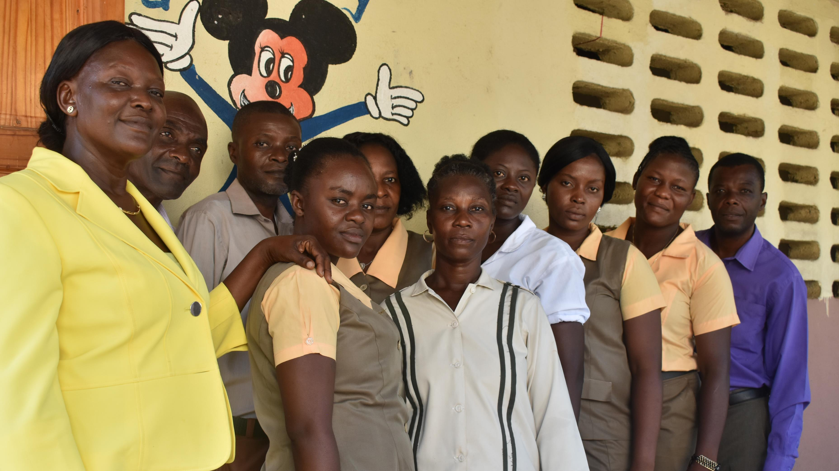

Slide 33
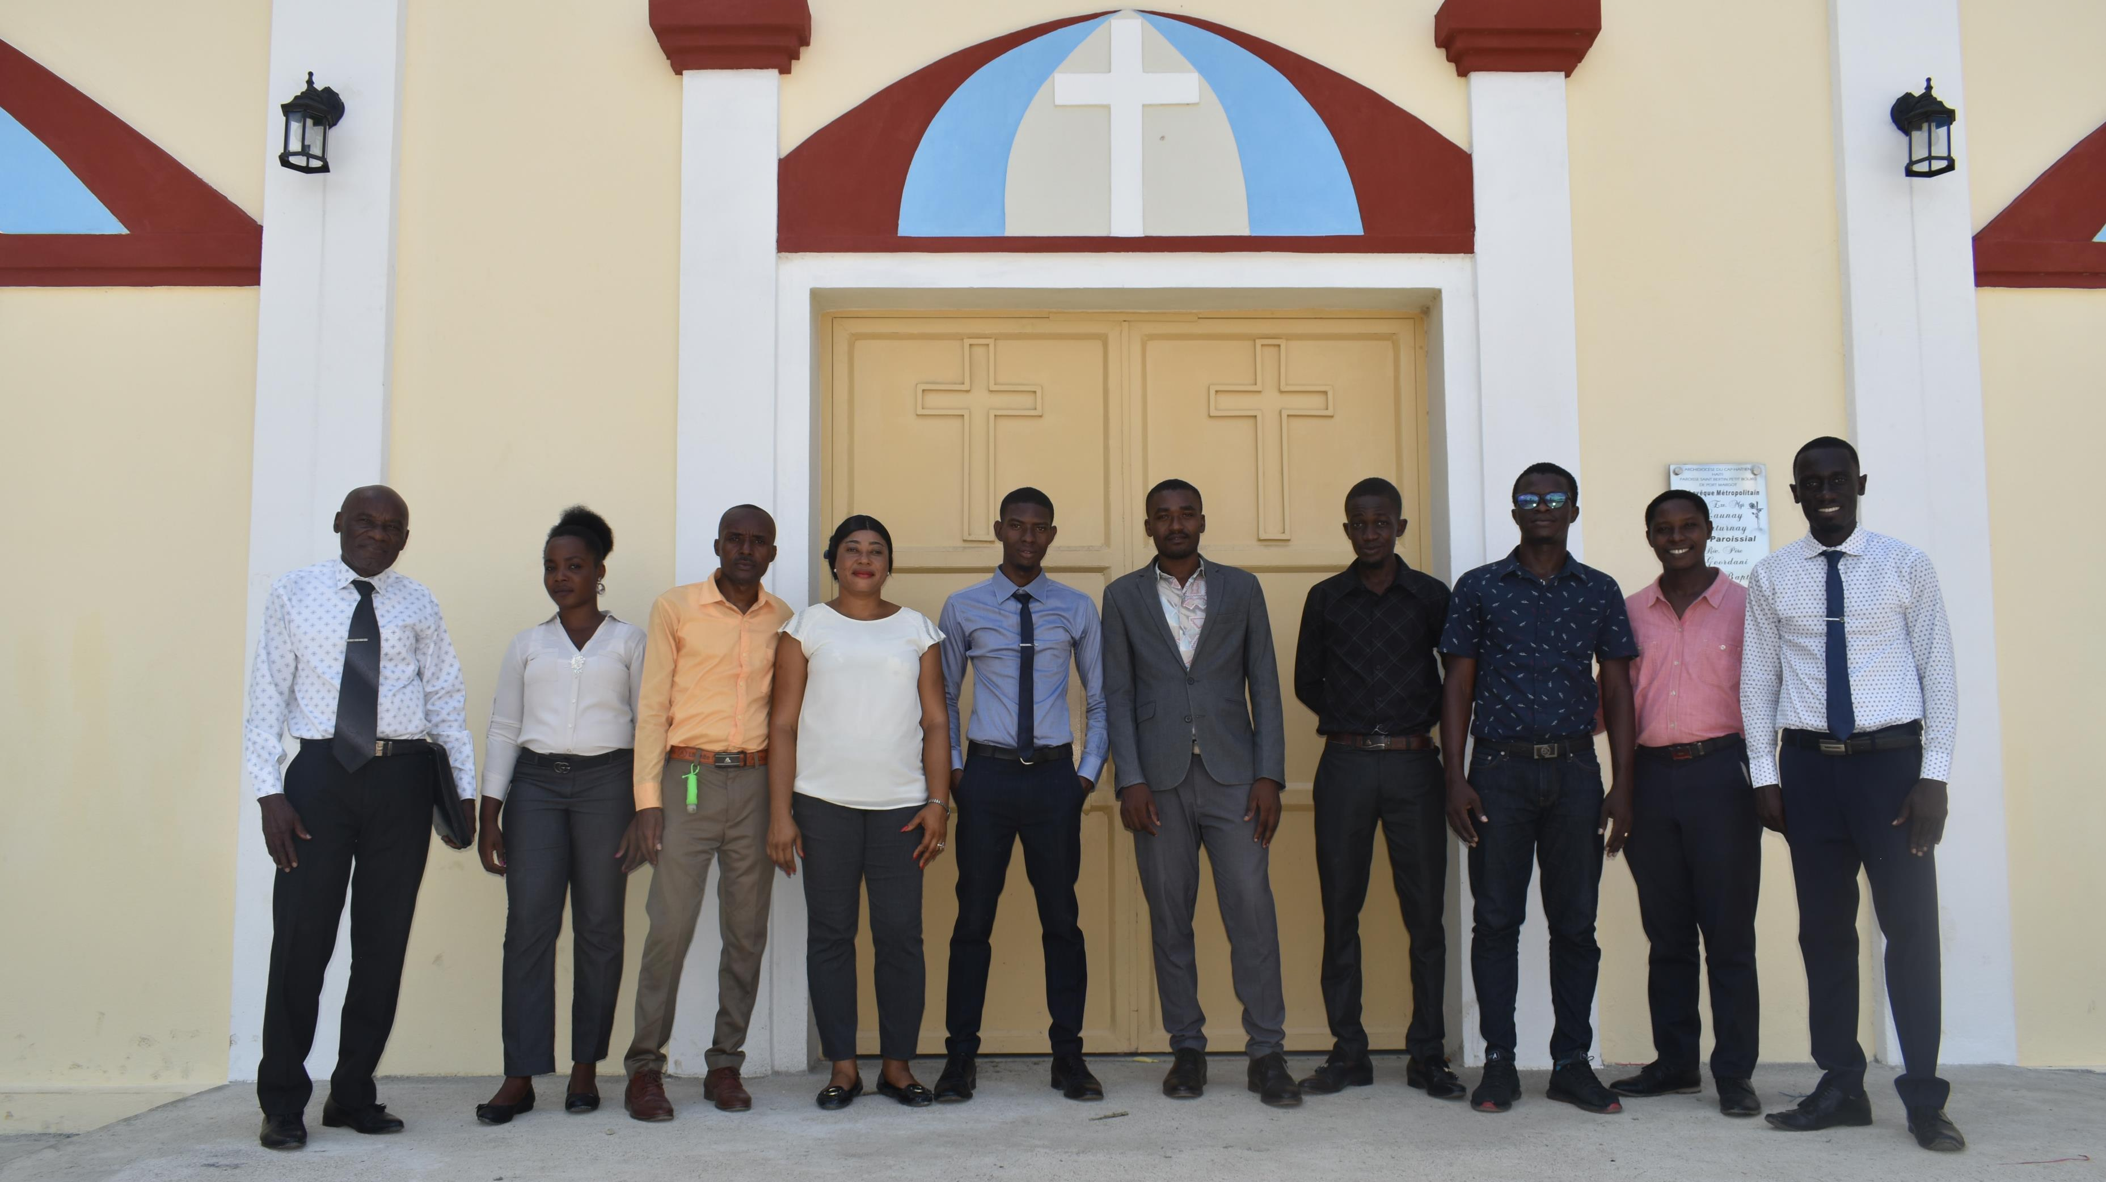

Slide 34
… affordable tuition
for parents

Slide 35
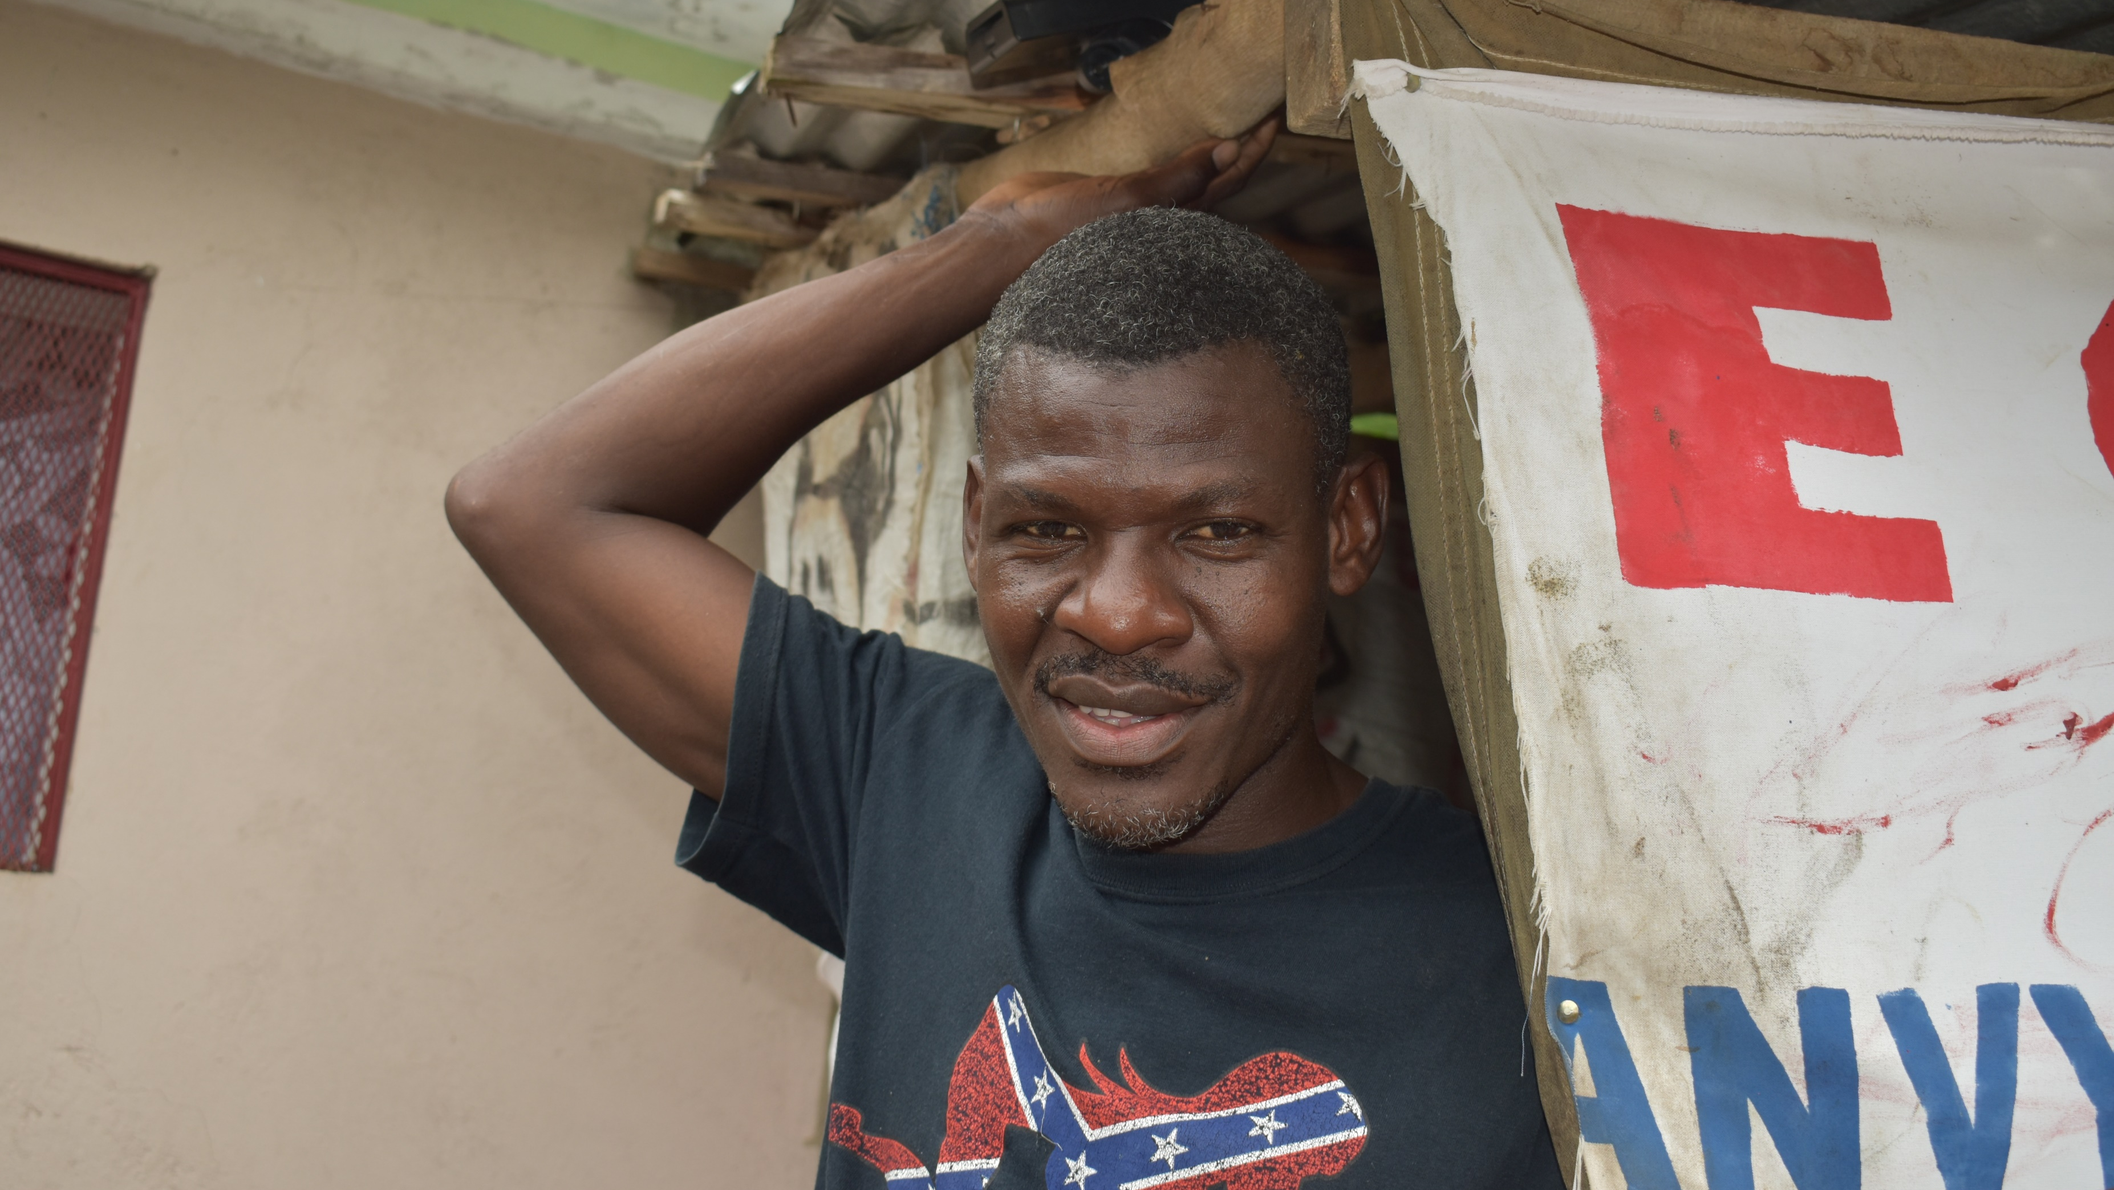

Slide 37
… and a quality education for the students.

Slide 39
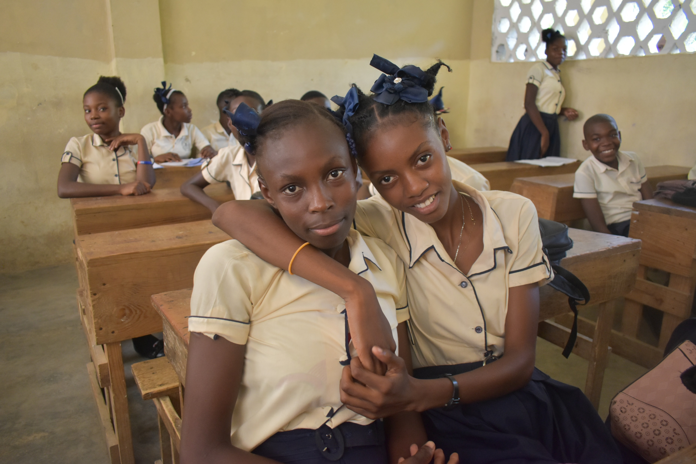

Slide 40
PLEASE prayerfully consider making a donation for St. Bertin School.

Slide 43
Bondye beni ou!
May God bless you!

